Slide 1

AE 482
Agric Engineering Design Project
UNIT 3: Engine Performance Characteristics
Mr. Joseph AVEYIRE
aveyire@yahoo.com // 024 4652593

Slide 2
Introduction
Unit three handles engine performance characteristics and takes a look into the tractor engine power. It
Identifies the performance characteristics of internal combustion engine, and
Considers the power that can be obtained from a tractor engine.

Slide 3
UNIT 3: Learning Objectives
Determine the power and efficiency of an engine
Explain engine torque and efficient loading
Determine the fuel consumption of an engine
Identify sources of power from a tractor engine
Identify the various types of dynamometers
Determine procedure of testing an engine

Slide 4
UNIT 3: Engine Performance Characteristics
Engine performance is an indication of the degree of success with which the engine performs its assigned task.
Engine performance is evaluated on the basis of:
Performance parameters and
the particular application of the engine
For example, for an aircraft engine specific weight is more important than the specific fuel consumption

Slide 5
UNIT 3: Engine Performance Characteristics
Basic performance parameters include the following:
Power and Mechanical Efficiency.
Mean Effective Pressure and Torque.
Specific Output.
Volumetric Efficiency.
Fuel-air Ratio.
Specific Fuel Consumption.
Thermal Efficiency and Heat Balance.
Specific Weight

Slide 6
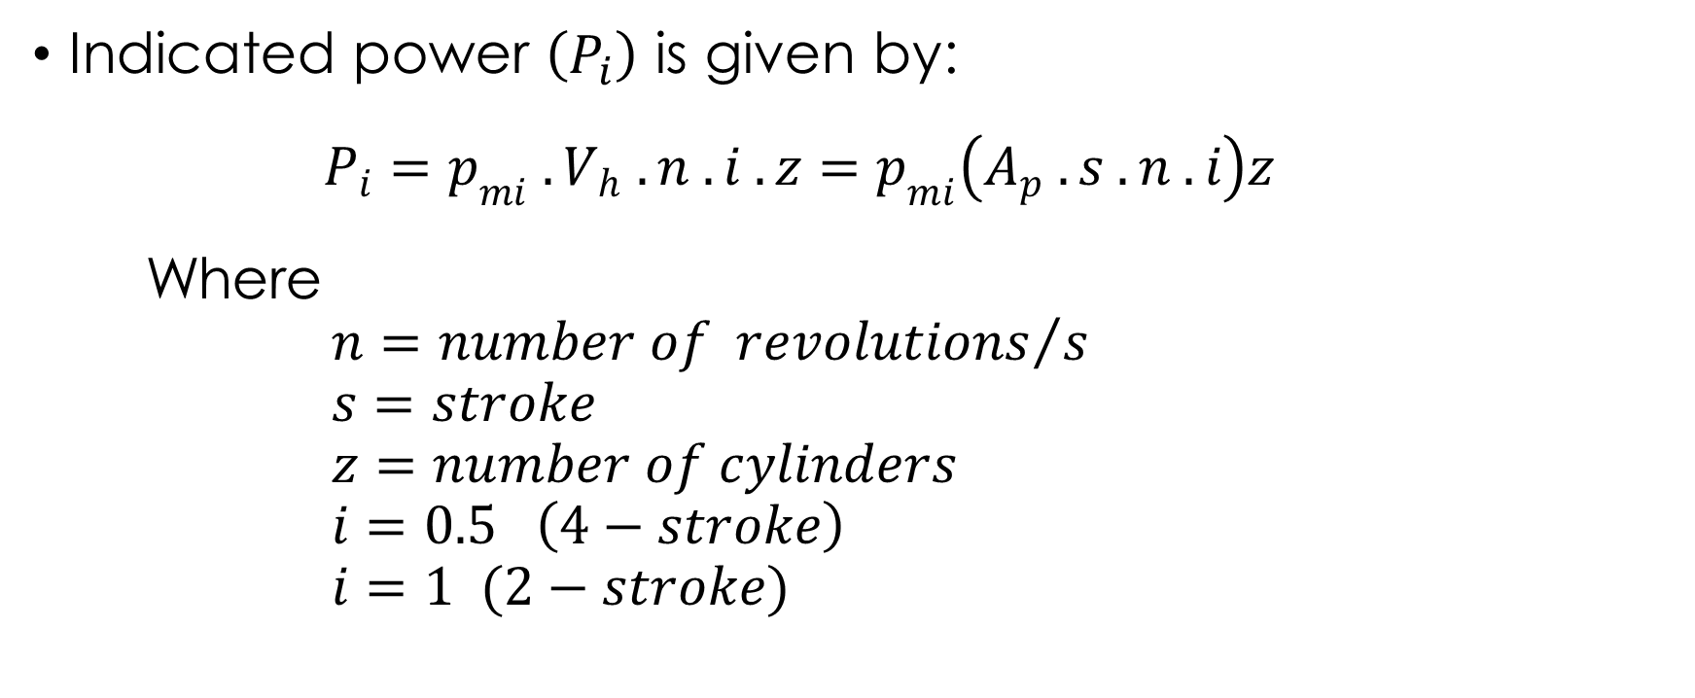
UNIT 3: Power and Mechanical Efficiency
Indicated power $\left(P_{i}\right)$ is given by:
$$P_{i}=p_{mi} . V_{h} . n . i . z=p_{mi}\left(A_{p} . s . n . i\right)z$$
Where
$$n={number of revolutions}/s$$
$$s=stroke$$
$$z=number of cylinders$$
$$i=0.5 \left(4−stroke\right)$$
$$i=1 (2−stroke)$$

Slide 7
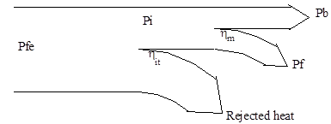
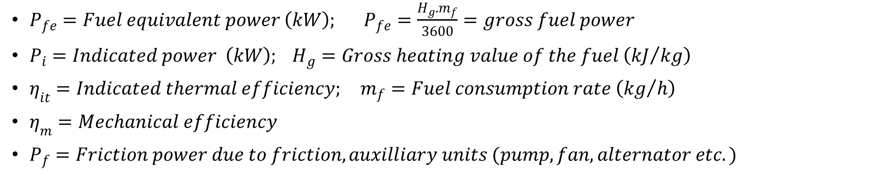
UNIT 3: Power and Mechanical Efficiency
$P_{fe}=Fuel equivalent power \left(kW\right); P_{fe}=\frac{H_{g}.m_{f}}{3600}=gross fuel power$
$P_{i}=Indicated power \left(kW\right); H_{g}=Gross heating value of the fuel \left({kJ}/{kg}\right)$
$η_{it}=Indicated thermal efficiency; m_{f}=Fuel consumption rate \left({kg}/h\right)$
$η_{m}=Mechanical efficiency$
$P_{f}=Friction power due to friction, auxilliary units (pump, fan, alternator etc.)$

Slide 8
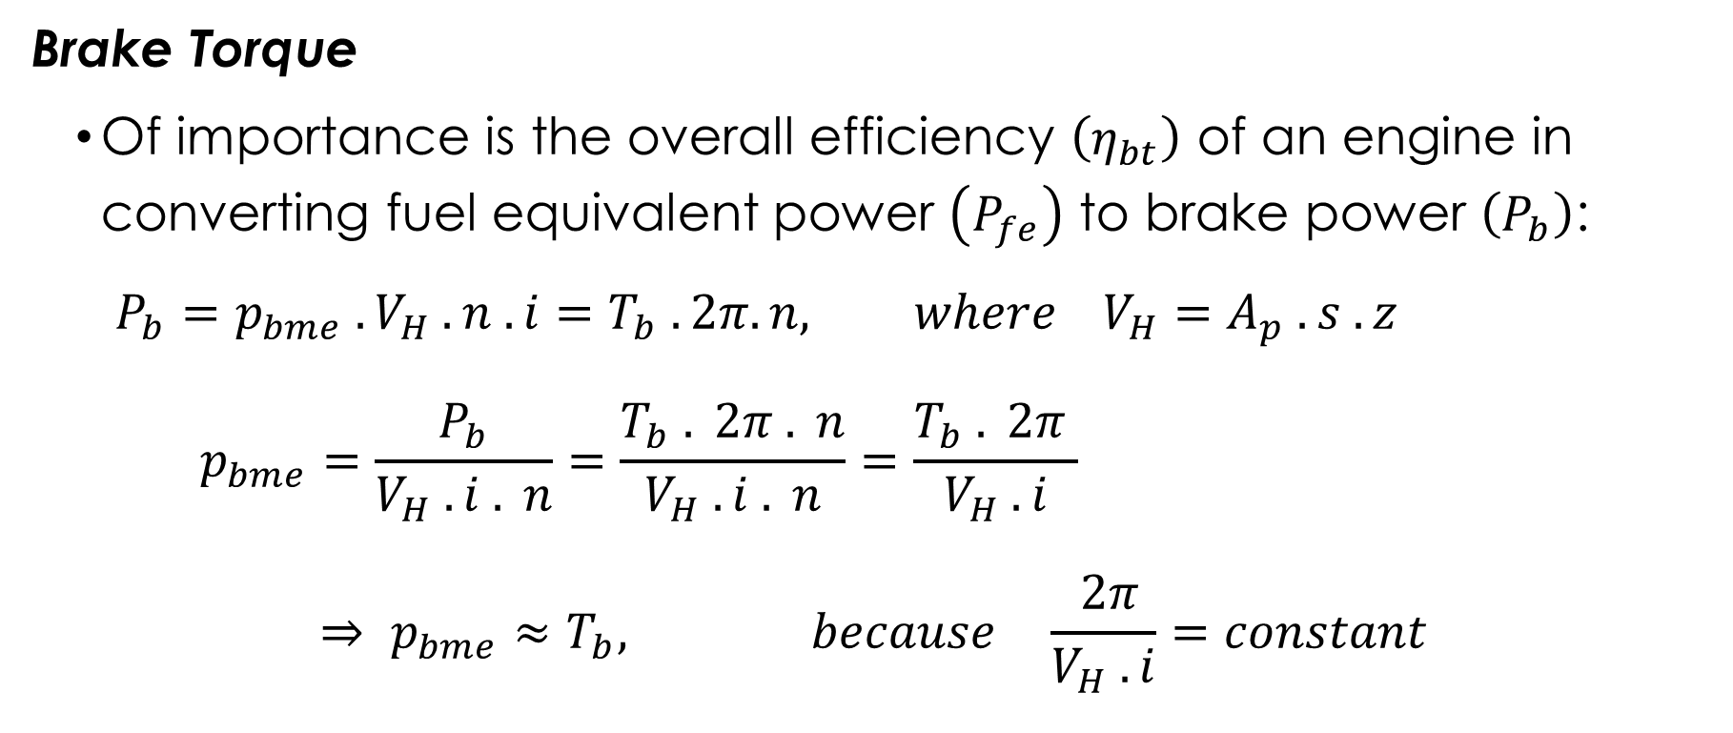
UNIT 3: Power and Mechanical Efficiency
Brake Torque
Of importance is the overall efficiency $\left(η_{bt}\right)$ of an engine in converting fuel equivalent power $\left(P_{fe}\right)$ to brake power $\left(P_{b}\right)$:
$$P_{b}=p_{bme} . V_{H} . n . i=T_{b} . 2π. n, where V_{H}=A_{p} . s . z$$
$$p_{bme}=\frac{P_{b}}{V_{H} . i . n}=\frac{T_{b} . 2π . n}{V_{H} . i . n}=\frac{T_{b} . 2π }{V_{H} . i}$$
$$⇒ p_{bme}≈T_{b}, because \frac{ 2π}{V_{H} . i}=constant$$

Slide 9
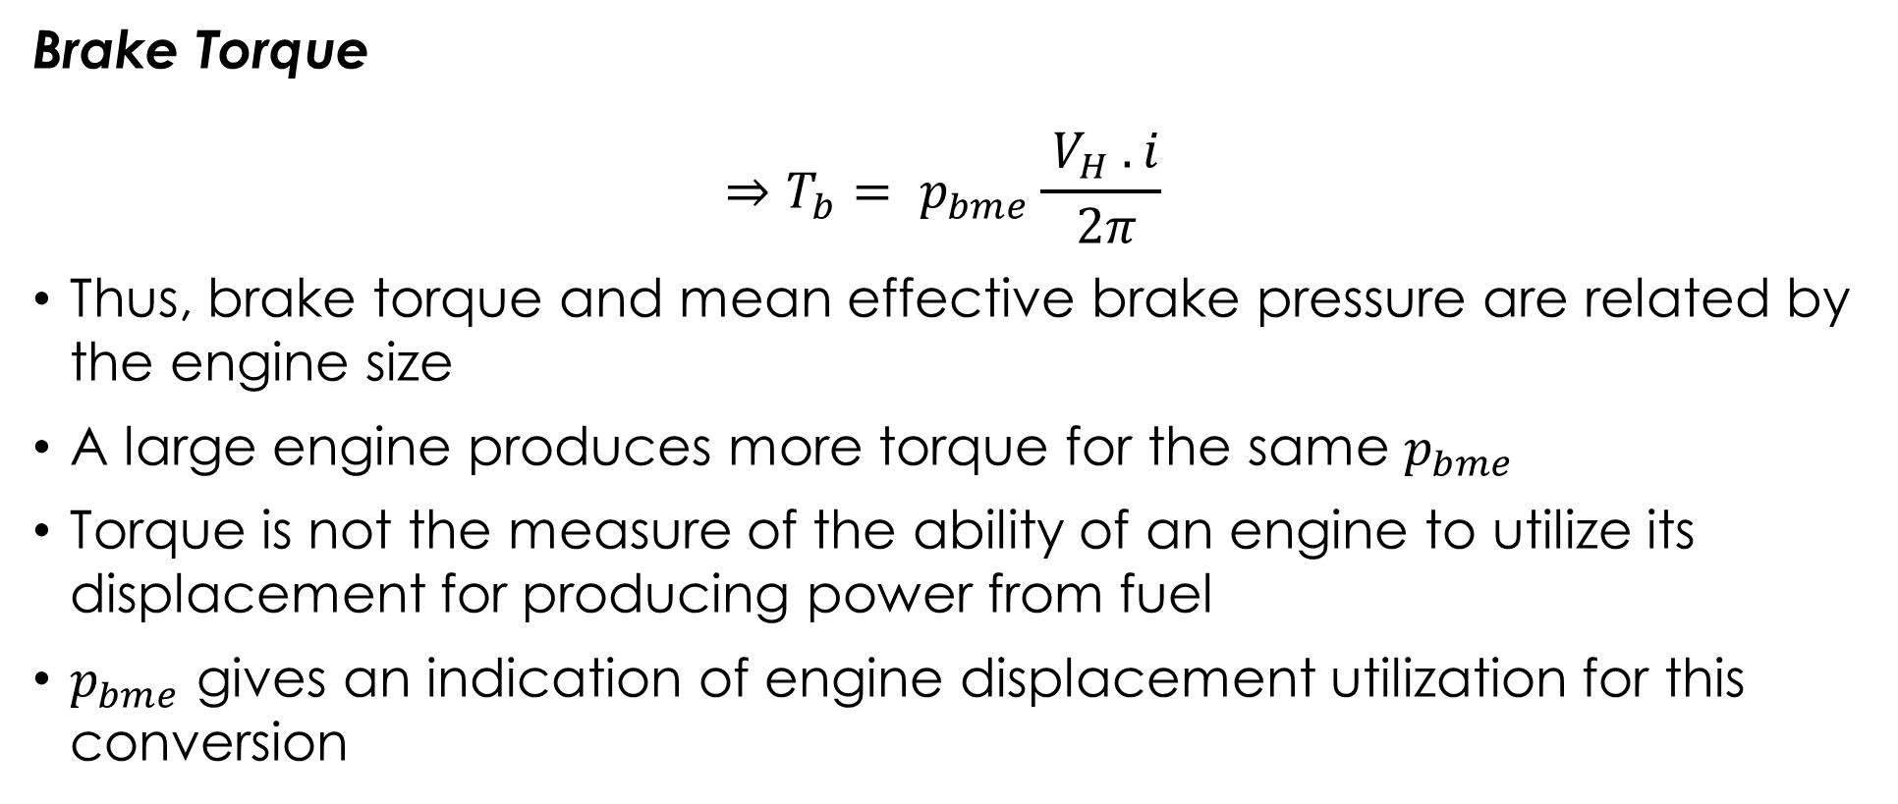
UNIT 3: Power and Mechanical Efficiency
Brake Torque
$$⇒T_{b}= p_{bme}\frac{ V_{H} . i}{ 2π}$$
Thus, brake torque and mean effective brake pressure are related by the engine size
A large engine produces more torque for the same $p_{bme}$
Torque is not the measure of the ability of an engine to utilize its displacement for producing power from fuel
$p_{bme}$ gives an indication of engine displacement utilization for this conversion

Slide 10
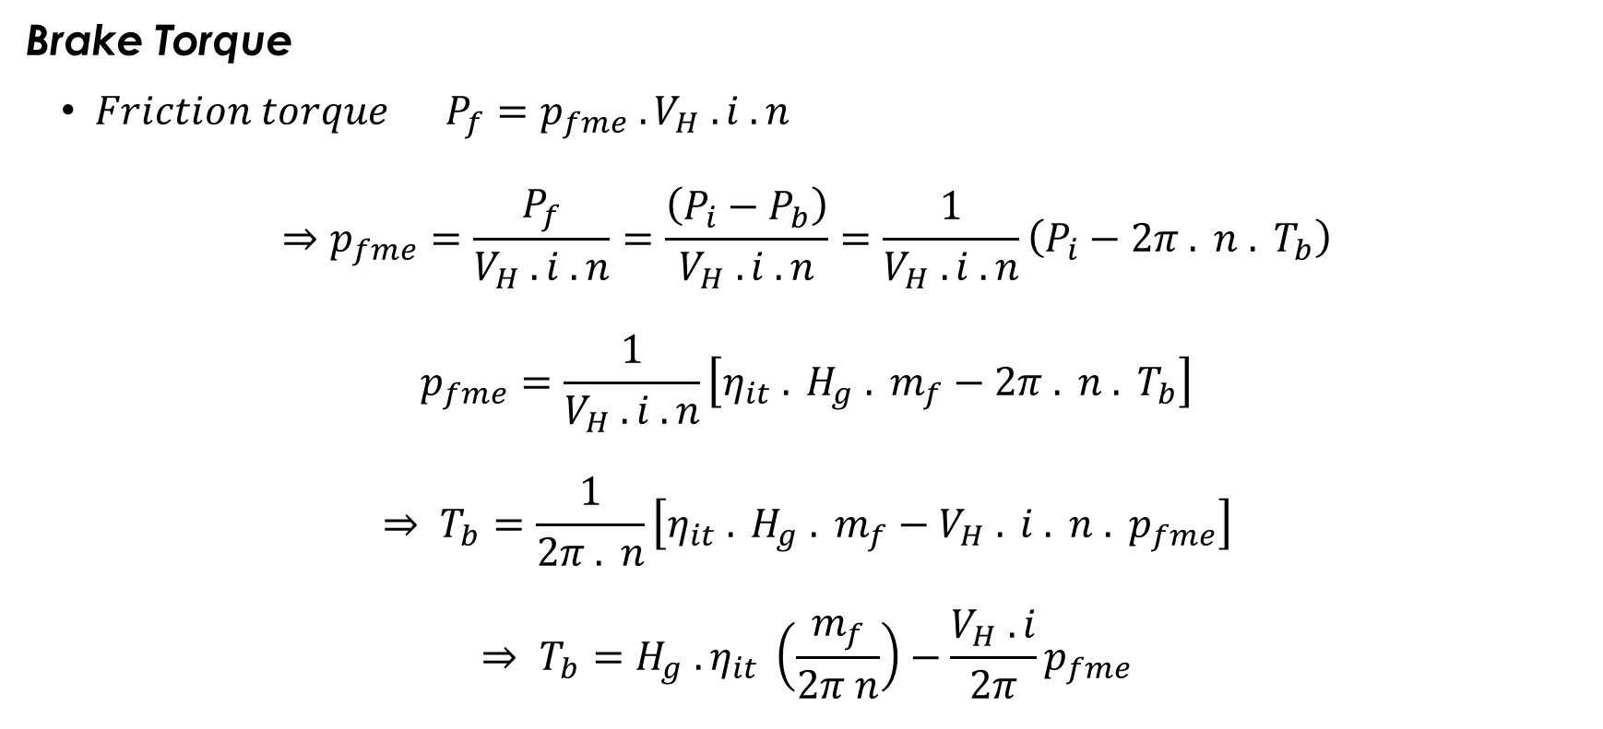
UNIT 3: Engine Torque and Efficient Loading
Brake Torque
$Friction torque P_{f}=p_{fme} . V_{H} . i . n$
$$⇒p_{fme}=\frac{P_{f}}{V_{H} . i . n}=\frac{\left(P_{i}−P_{b}\right)}{V_{H} . i . n}=\frac{1}{V_{H} . i . n}\left(P_{i}−2π . n . T_{b}\right)$$
$$p_{fme}=\frac{1}{V_{H} . i . n}\left[η_{it} . H_{g} . m_{f}−2π . n . T_{b}\right]$$
$$⇒ T_{b}=\frac{1}{2π . n}\left[η_{it} . H_{g} . m_{f}−V_{H} . i . n . p_{fme}\right]$$
$$⇒ T_{b}=H_{g} . η_{it} \left(\frac{m_{f}}{2π n}\right)−\frac{V_{H} . i}{2π}p_{fme}$$

Slide 11
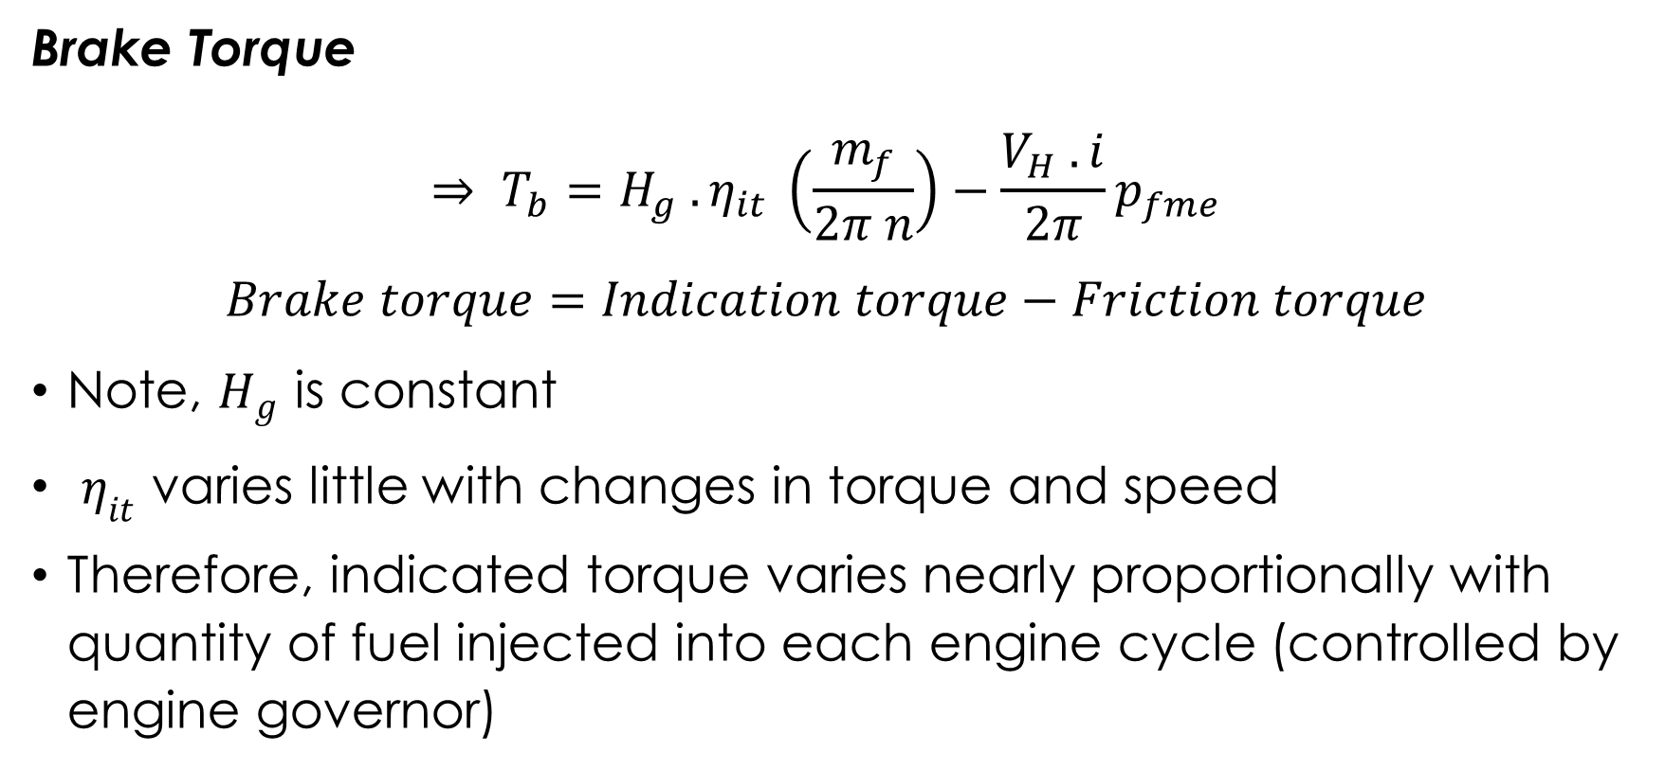
UNIT 3: Engine Torque and Efficient Loading
Brake Torque
$$⇒ T_{b}=H_{g} . η_{it} \left(\frac{m_{f}}{2π n}\right)−\frac{V_{H} . i}{2π}p_{fme}$$
$$Brake torque=Indication torque−Friction torque$$
Note, $H_{g}$ is constant
$η_{it}$ varies little with changes in torque and speed
Therefore, indicated torque varies nearly proportionally with quantity of fuel injected into each engine cycle (controlled by engine governor)

Slide 12
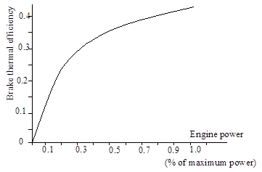
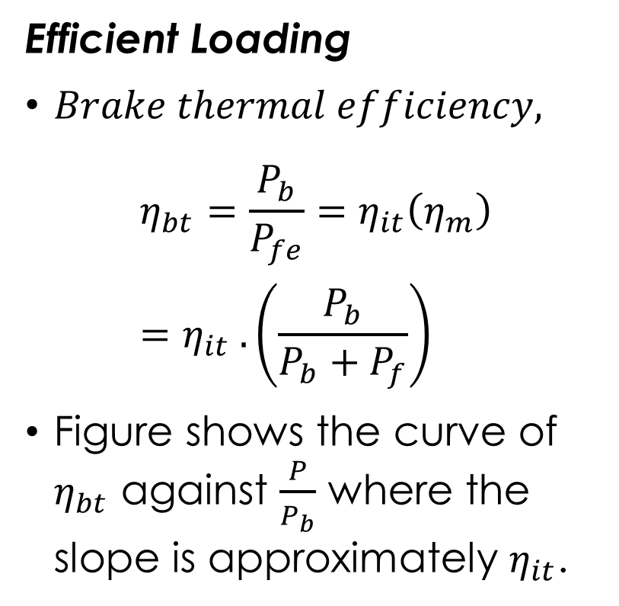
UNIT 3: Engine Torque and Efficient Loading
Efficient Loading
$Brake thermal efficiency,$
$$η_{bt}=\frac{P_{b}}{P_{fe}}=η_{it}\left(η_{m}\right)=η_{it} . \left(\frac{P_{b}}{P_{b}+P_{f}}\right)$$
Figure shows the curve of $η_{bt}$ against $\frac{P}{P_{b}}$ where the slope is approximately $η_{it}$.

Slide 13
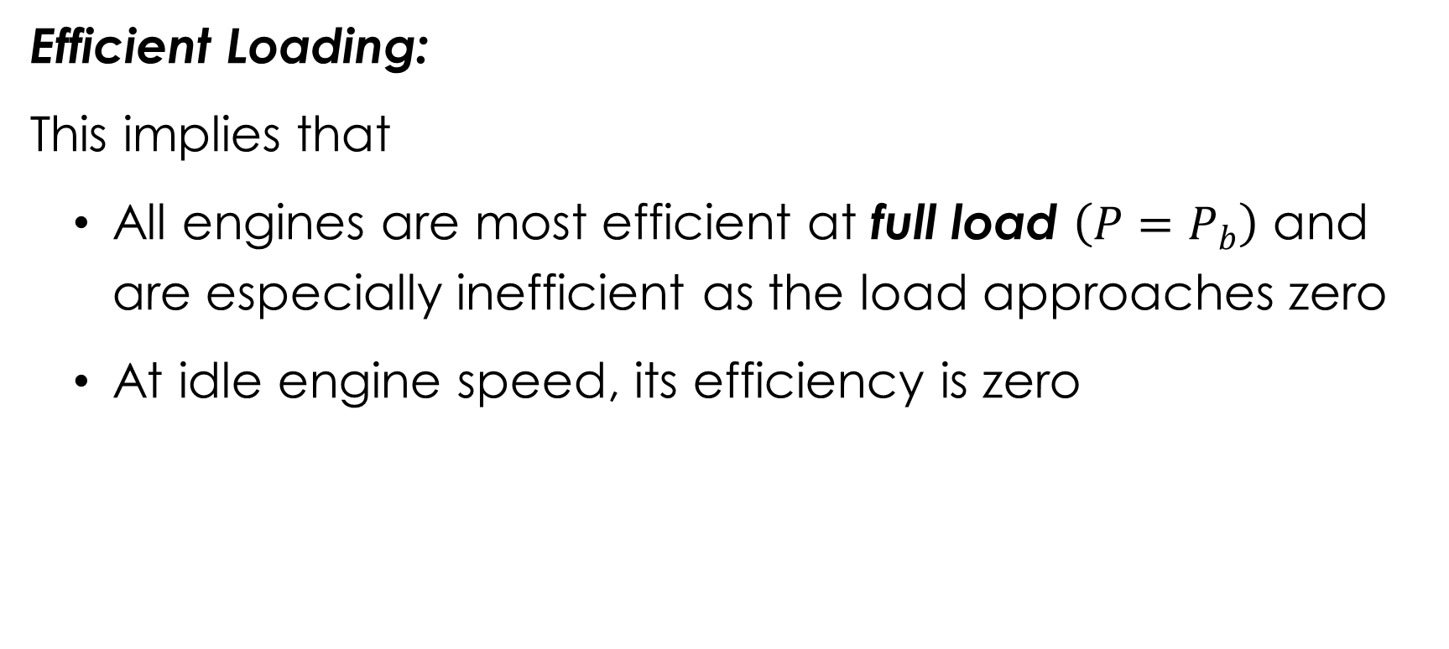
UNIT 3: Engine Torque and Efficient Loading
  Efficient Loading:
  This implies that
  All engines are most efficient at full load $\left(P=P_{b}\right)$ and are especially inefficient as the load approaches zero
  At idle engine speed, its efficiency is zero

Slide 14
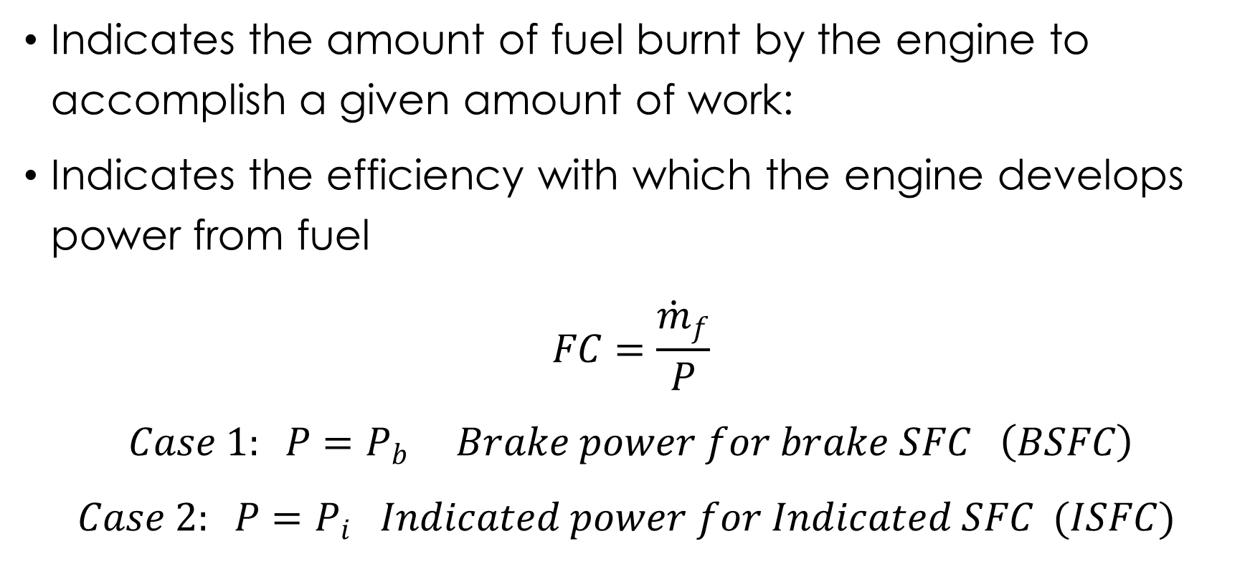
UNIT 3: Specific Fuel Consumption
Indicates the amount of fuel burnt by the engine to accomplish a given amount of work:
Indicates the efficiency with which the engine develops power from fuel
$$FC=\frac{{\dot{m}}_{f}}{P}$$
$$Case 1: P=P_{b} Brake power for brake SFC \left(BSFC\right)$$
$$Case 2: P=P_{i} Indicated power for Indicated SFC (ISFC)$$

Slide 15
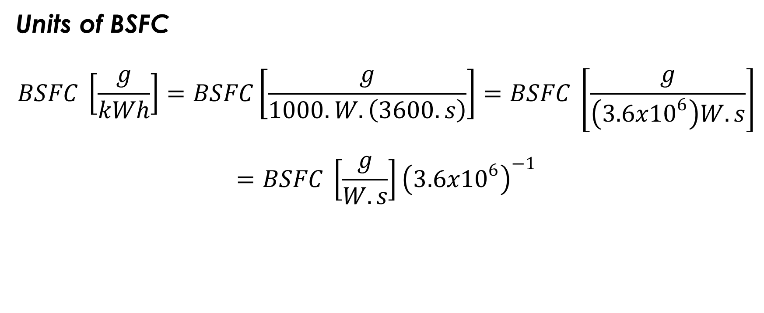
UNIT 3: Specific Fuel Consumption
Units of BSFC
$$BSFC \left[\frac{g}{kWh}\right]=BSFC\left[\frac{g}{1000.W.\left(3600.s\right)}\right]=BSFC \left[\frac{g}{\left(3.6x{10}^{6}\right)W.s}\right]$$
$$=BSFC \left[\frac{g}{W.s}\right]{\left(3.6x{10}^{6}\right)}^{−1}$$

Slide 16
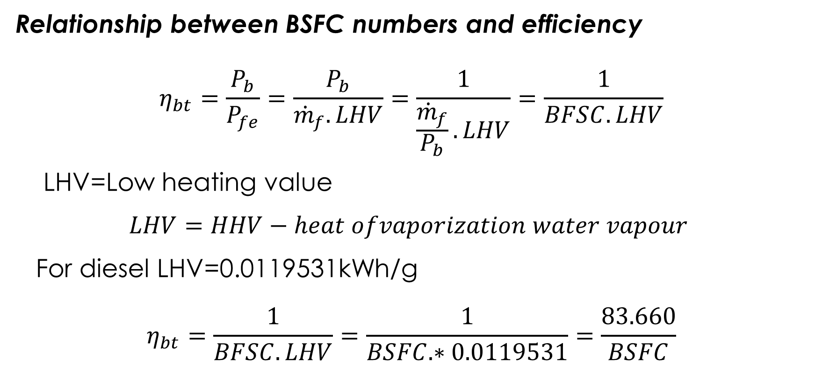
UNIT 3: Specific Fuel Consumption
Relationship between BSFC numbers and efficiency
$$η_{bt}=\frac{P_{b}}{P_{fe}}=\frac{P_{b}}{{\dot{m}}_{f}.LHV}=\frac{1}{\frac{{\dot{m}}_{f}}{P_{b}}.LHV}=\frac{1}{BFSC.LHV}$$
LHV=Low heating value
$$LHV=HHV−heat ofvaporization water vapour$$
For diesel LHV=0.0119531kWh/g
$$η_{bt}=\frac{1}{BFSC.LHV}=\frac{1}{BSFC.∗0.0119531}=\frac{83.660}{BSFC}$$

Slide 17
UNIT 3: Tractor Power Measurements
Terminology:
Brake power is the power
Pto-power
Draw bar power
Friction power
Indicated power
Maximum brake power
Observed power
Corrected power
Rated horsepower

Slide 18
UNIT 3: Tractor Power Measurements
Example 1:
A certain compression ignition engine consumes No.. 2 diesel fuel (Hg=45,000 kJ/kg) at the rate of 26.3 kg/h while running at a rated speed of 2200 rpm and producing 595 Nm of torque. Assuming the mechanical efficiency is 0.85.
Calculate the fuel equivalent power,
Calculate the brake power,
Calculate the indicated power,
Calculate the friction power,
Calculate the indicated thermal efficiency,
Calculate the brake thermal efficiency,
Calculate the BSFC

Slide 19
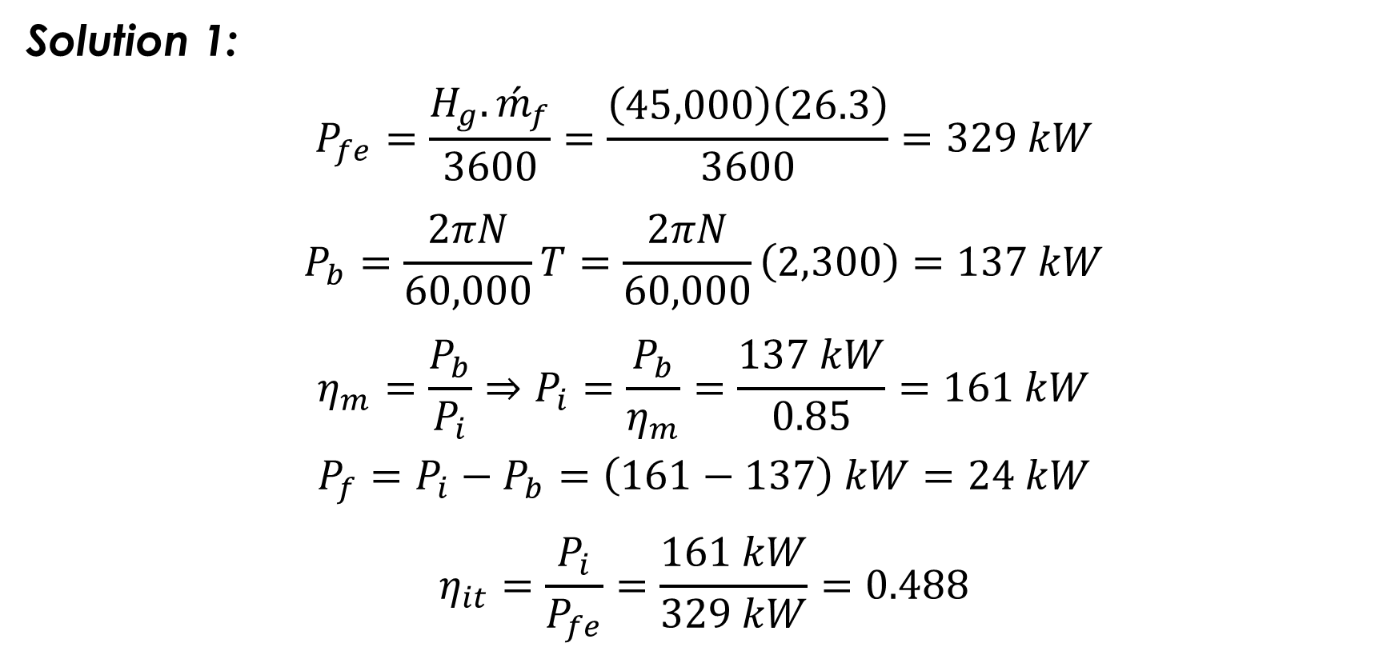
UNIT 3: Tractor Power Measurements
Solution 1:
$$P_{fe}=\frac{H_{g}.{\acute{m}}_{f}}{3600}=\frac{\left(45,000\right)\left(26.3\right)}{3600}=329 kW$$
$$P_{b}=\frac{2πN}{60,000}T=\frac{2πN}{60,000}\left(2,300\right)=137 kW$$
$$η_{m}=\frac{P_{b}}{P_{i}}⇒P_{i}=\frac{P_{b}}{η_{m}}=\frac{137 kW}{0.85}=161 kW$$
$$P_{f}=P_{i}−P_{b}=\left(161−137\right) kW=24 kW$$
$$η_{it}=\frac{P_{i}}{P_{fe}}=\frac{161 kW}{329 kW}=0.488$$

Slide 20
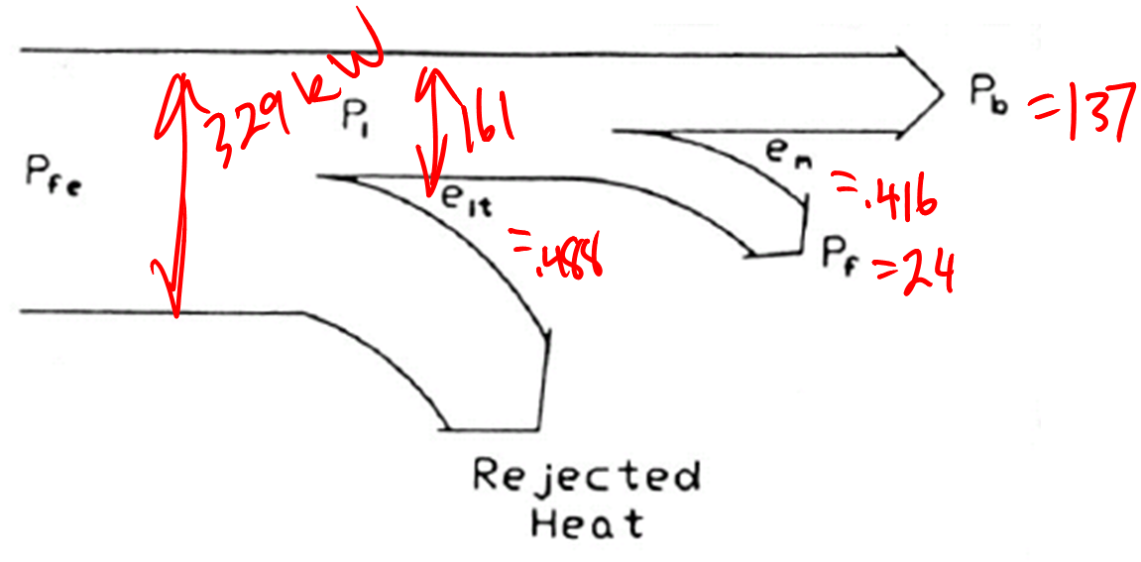
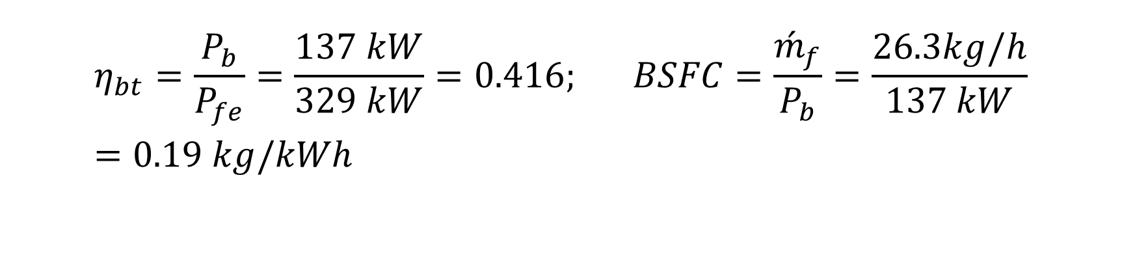
UNIT 3: Tractor Power Measurements
$$η_{bt}=\frac{P_{b}}{P_{fe}}=\frac{137 kW}{329 kW}=0.416; BSFC=\frac{{\acute{m}}_{f}}{P_{b}}=\frac{26.3kg/h}{137 kW}=0.19 kg/kWh$$

Slide 21
UNIT 3: Tractor Power Measurements
Example:
Consider an engine rated as 595 Nm,(137 kW) at 2299 rpm has an idle speed of 2400 rpm and a torque reserve of 30%; Peak torque occurs at 1300 rpm. Sketch the torque and power curves (versus engine speed).

Slide 22
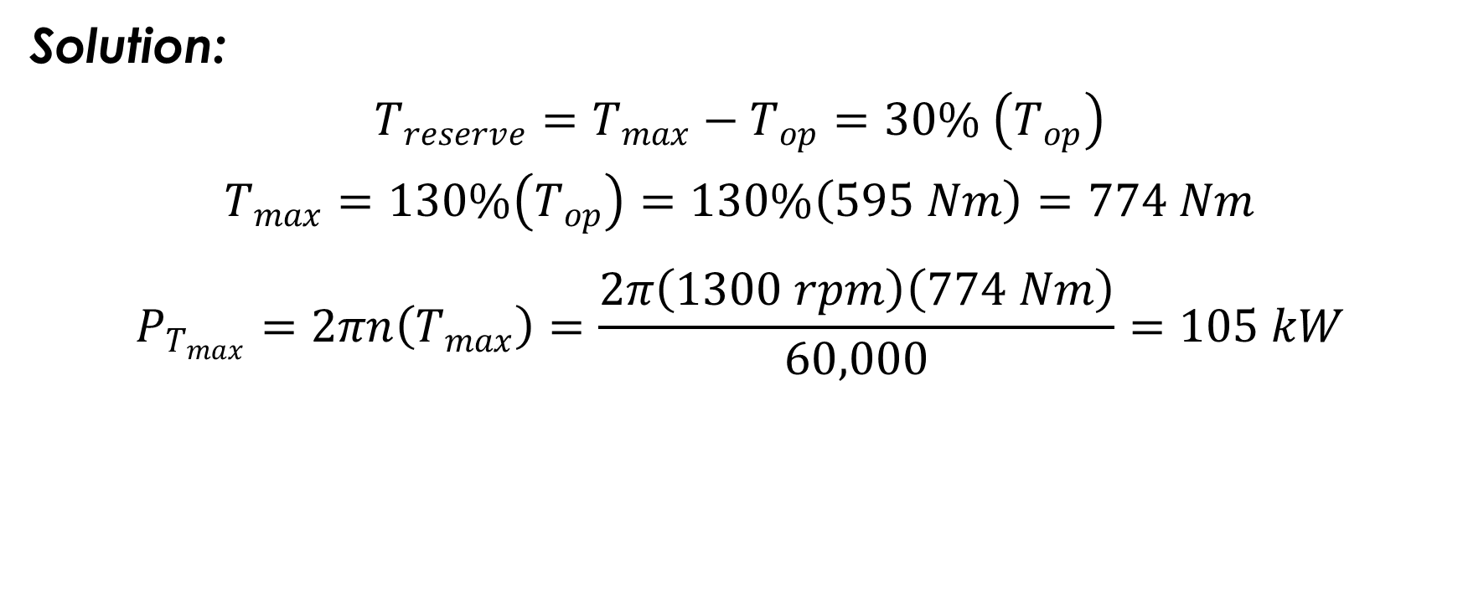
UNIT 3: Tractor Power Measurements
Solution:
$$T_{reserve}=T_{max}−T_{op}=30\% \left(T_{op}\right)$$
$$T_{max}=130\%\left(T_{op}\right)=130\%\left(595 Nm\right)=774 Nm$$
$$P_{T_{max}}=2πn\left(T_{max}\right)=\frac{2π\left(1300 rpm\right)\left(774 Nm\right)}{60,000}=105 kW$$

Slide 23
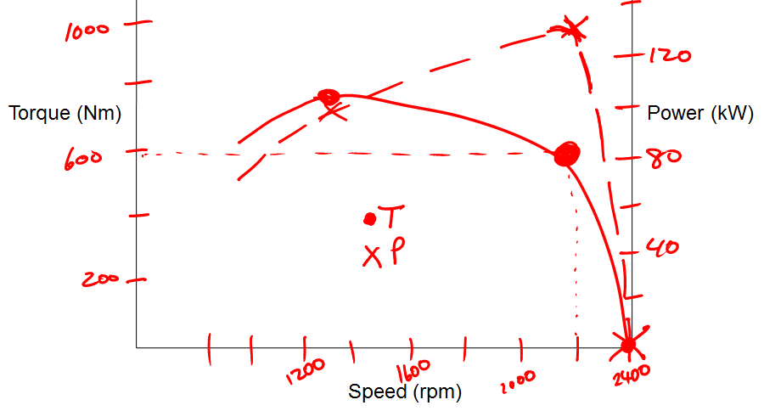
UNIT 3: Tractor Power Measurements

Slide 24
UNIT 3: Types of Dynamometers
Dynamometer is an instrument for determining power usually by the independent measure of force, time and the distance through which the force is moved
Brake Dynamometers
Drawbar Dynamometers
Torsion Dynamometers
Transmission Dynamometer
Absorption Dynamometers

Slide 25
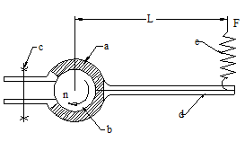
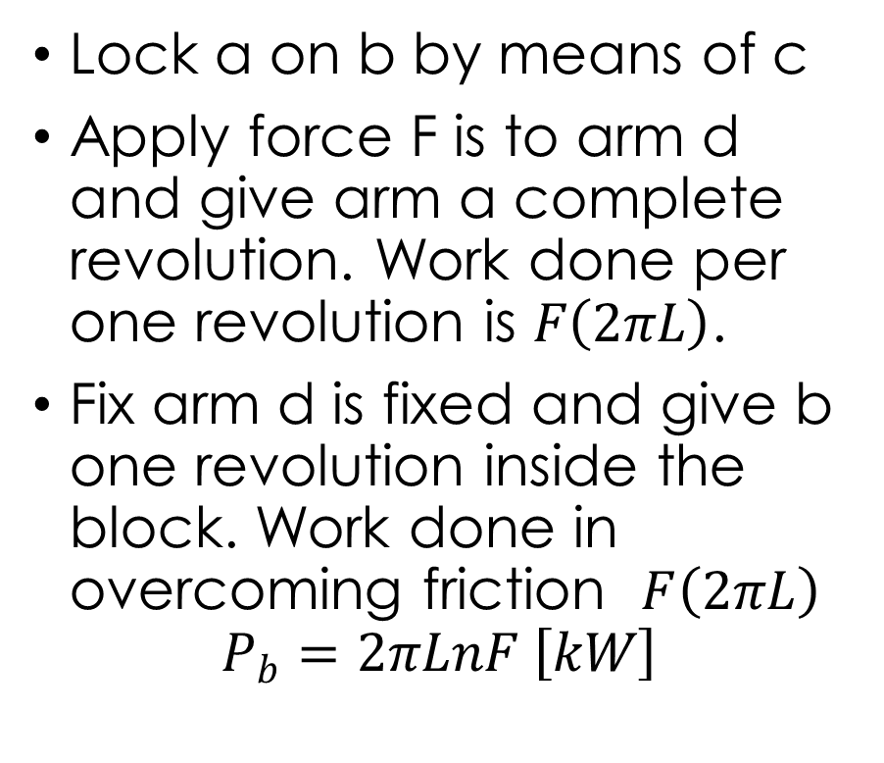
UNIT 3: Prony Brake Dynamometer
Lock a on b by means of c
Apply force F is to arm d and give arm a complete revolution. Work done per one revolution is $F\left(2πL\right)$.
Fix arm d is fixed and give b one revolution inside the block. Work done in overcoming friction $F\left(2πL\right)$
$$P_{b}=2πLnF \left[kW\right]$$

Slide 26
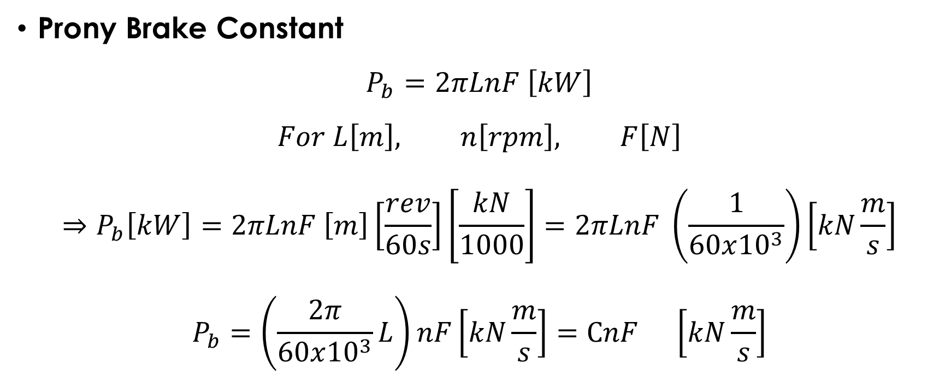
UNIT 3: Prony Brake Dynamometer
Prony Brake Constant
$$P_{b}=2πLnF \left[kW\right]$$
$$For L\left[m\right], n\left[rpm\right], F\left[N\right]$$
$$⇒P_{b}\left[kW\right]=2πLnF \left[m\right]\left[\frac{rev}{60s}\right]\left[\frac{kN}{1000}\right]=2πLnF \left(\frac{1}{60x{10}^{3}}\right)\left[kN\frac{m}{s}\right]$$
$$P_{b}=\left(\frac{2π}{60x{10}^{3}}L\right)nF\left[kN\frac{m}{s}\right]=CnF \left[kN\frac{m}{s}\right]$$

Slide 27
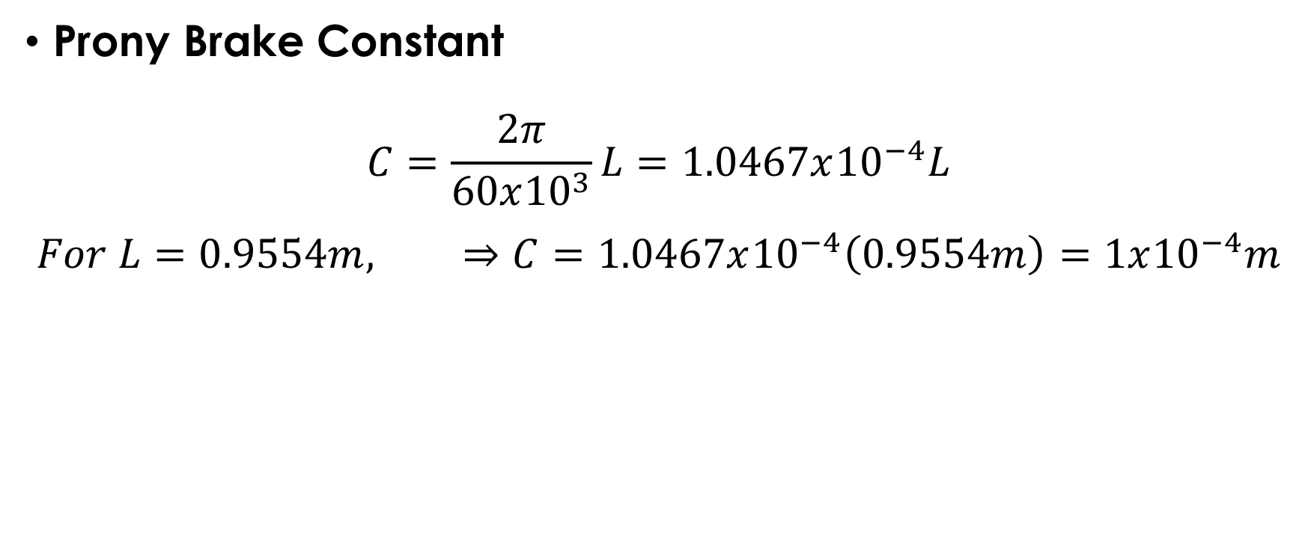
UNIT 3: Prony Brake Dynamometer
Prony Brake Constant
$$C=\frac{2π}{60x{10}^{3}}L=1.0467x{10}^{−4}L$$
$$For L=0.9554m, ⇒C=1.0467x{10}^{−4}\left(0.9554m\right)=1x{10}^{−4}m$$

Slide 28
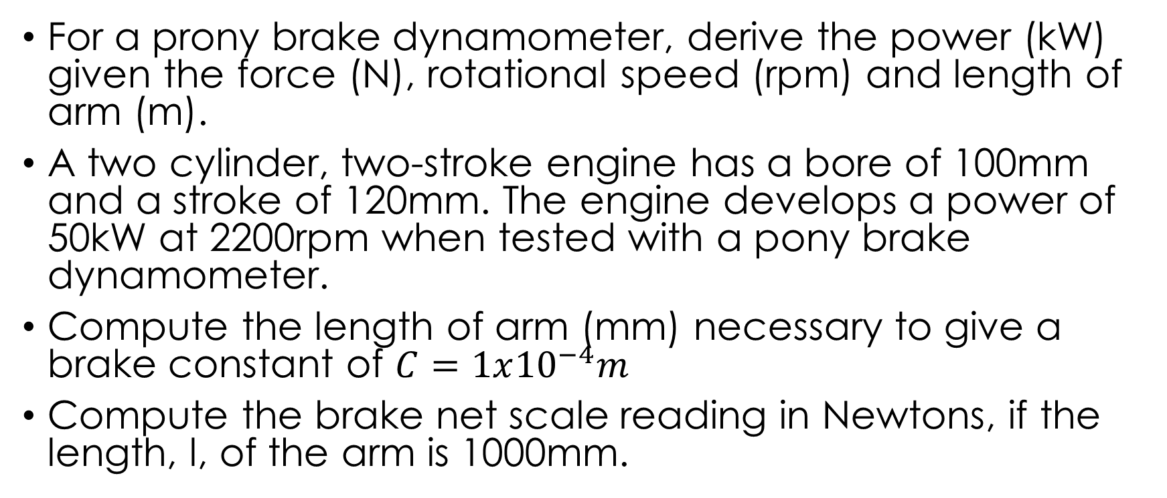
Example
For a prony brake dynamometer, derive the power (kW) given the force (N), rotational speed (rpm) and length of arm (m).
A two cylinder, two-stroke engine has a bore of 100mm and a stroke of 120mm. The engine develops a power of 50kW at 2200rpm when tested with a pony brake dynamometer.
Compute the length of arm (mm) necessary to give a brake constant of $C=1x{10}^{−4}m$
Compute the brake net scale reading in Newtons, if the length, l, of the arm is 1000mm.

Slide 29

Thank You
For any concerns, please contact
elearning@knust.edu.gh
elearningknust@gmail.com
0322 191132

